Slide 1
UNIT-I Introduction to AI
A7702 - AI Tools

Slide 2
Course Learning Outcomes
After the completion of the course, the student will be able to:
Illustrate the concepts of artificial intelligence in real time applications.
Demonstrate various types of machine learning algorithms to analyze data.
Identify the methods and algorithms in processing an image.
Choose different applications of AI using natural language processing.
Identify the requirements for chatbots in daily life.

Slide 3
Attendance
You are expected to attend all the lectures. The lecture notes cover all the topics in the course, but these notes are concise, and do not contain much in the way of discussion, motivation or examples. The lectures will consist of slides (PowerPoint), spoken material, and additional examples given on the blackboard. In order to understand the subject and the reasons for studying the material, you will need to attend the lectures and take notes to supplement lecture slides. This is your responsibility. If there is anything you do not understand during the lectures, then ask, either during or after the lecture. If there is anything you do not understand in the slides, then ask.
All students must use text book and references.

Slide 4
Artificial Intelligence
“The science and engineering of making intelligent machines, especially intelligent computer programs”. -John McCarthy
Artificial Intelligence is an approach to make a computer, a robot, or a product to think how smart human think.
AI is a study of how human brain think, learn, decide and work, when it tries to solve problems. And finally this study outputs intelligent software systems.
The aim of AI is to improve computer functions which are related to human knowledge, for example, reasoning, learning, and problem-solving.

Slide 5
One of the booming technologies of computer science is Artificial Intelligence which is ready to create a new revolution in the world by making intelligent machines.
The Artificial Intelligence is now all around us. It is currently working with a variety of subfields, ranging from general to specific, such as self-driving cars, playing chess, proving theorems, playing music etc.,
Artificial Intelligence is composed of two words Artificial and Intelligence, where Artificial defines "man-made," and intelligence defines "thinking power", hence AI means "a man-made thinking power."

Slide 6
Definition of AI:
"It is a branch of computer science by which we can create intelligent machines which can behave like a human, think like humans, and able to make decisions."

Slide 7
Why Artificial Intelligence?
We should know that what is the importance of AI and why should we learn it. Following are some main reasons to learn about AI:
With the help of AI, you can create such software or devices which can solve real-world problems very easily and with accuracy such as health issues, marketing, traffic issues, etc.
With the help of AI, you can create your personal virtual Assistant, such as Cortana, Google Assistant, Siri, etc.
With the help of AI, you can build such Robots which can work in an environment where survival of humans can be at risk.
AI opens a path for other new technologies, new devices, and new Opportunities.

Slide 8
Advantages of Artificial Intelligence
High Accuracy with less errors: AI machines or systems are prone to less errors and high accuracy as it takes decisions as per pre-experience or information.
High-Speed: AI systems can be of very high-speed and fast-decision making, because of that AI systems can beat a chess champion in the Chess game.
High reliability: AI machines are highly reliable and can perform the same action multiple times with high accuracy.
Useful for risky areas: AI machines can be helpful in situations such as defusing a bomb, exploring the ocean floor, where to employ a human can be risky.

Slide 9
Digital Assistant: AI can be very useful to provide digital assistant to the users such as AI technology is currently used by various E-commerce websites to show the products as per customer requirement.
Useful as a public utility: AI can be very useful for public utilities such as a self-driving car which can make our journey safer and hassle-free, facial recognition for security purpose, Natural language processing to communicate with the human in human-language, etc.

Slide 10
Disadvantages of Artificial Intelligence
High Cost: The hardware and software requirement of AI is very costly as it requires lots of maintenance to meet current world requirements.
Can't think out of the box: Even we are making smarter machines with AI, but still they cannot work out of the box, as the robot will only do that work for which they are trained, or programmed.
No feelings and emotions: AI machines can be an outstanding performer, but still it does not have the feeling so it cannot make any kind of emotional attachment with human, and may sometime be harmful for users if the proper care is not taken.
Increase dependency on machines: With the increment of technology, people are getting more dependent on devices and hence they are losing their mental capabilities.
No Original Creativity: As humans are so creative and can imagine some new ideas but still AI machines cannot beat this power of human intelligence and cannot be creative and imaginative.

Slide 11
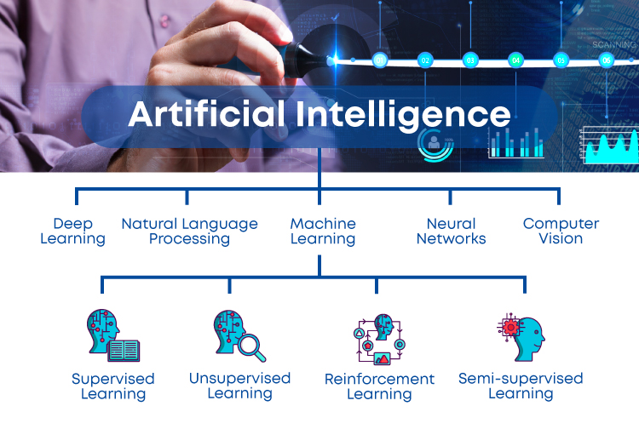

Slide 12
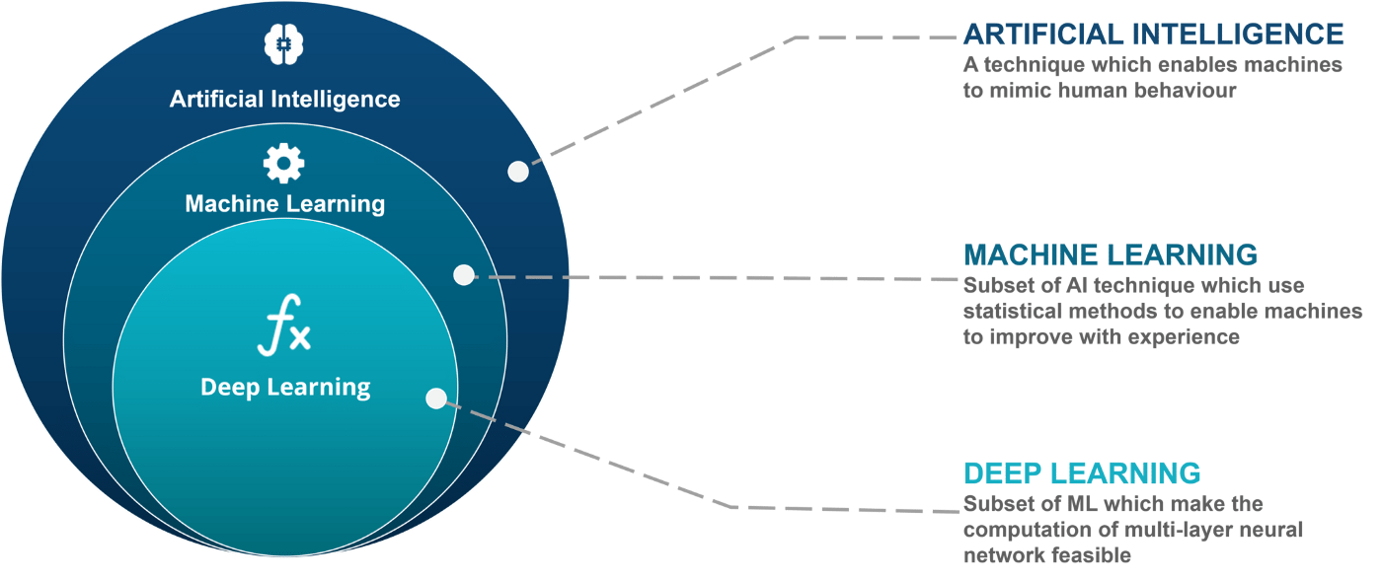

Slide 13
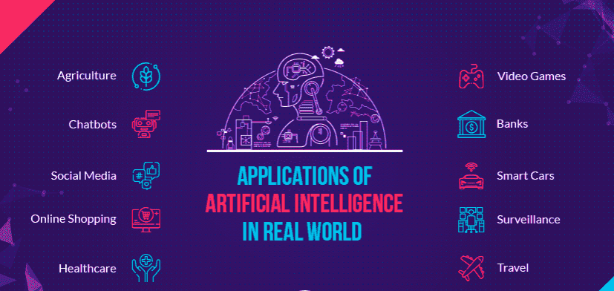

Slide 14
Symbolic AI
Symbolic AI is more commonly known as rule-based AI, good old-fashioned AI (GOFA), and classic AI.
Earlier AI development research was based on Symbolic AI which relied on inserting human behavior and knowledge in the form of computer codes.
We humans have used symbols to drive meaning from things and events in the environment around us.
For example, imagine you told your friend to buy you a bottle of Coke. Your friend would first have an image of a bottle of coke in his mind.
This is the very idea behind the symbolic AI development, that these symbols become the building block for cognition.

Slide 15
To construct intelligent systems, it is necessary to employ internal representations of a symbolic nature, with cognitive activity corresponding to computational manipulation of these symbolic representations.
The symbolic representations refer to the external world.

Slide 16
Non-symbolic AI
Knowledge is represented by weights on connections in a network.
Non-symbolic representation can deal with combinations of attributes, such as image.
Examples of Non-symbolic AI include genetic algorithms, neural networks and deep learning.
The origins of non-symbolic AI come from the attempt to mimic a human brain and its complex network of interconnected neurons.
Non-symbolic AI is applied to critical applications such as self-driving cars, medical diagnosis among others.

Slide 17
Research Focus areas of Artificial Intelligence
Large scale Machine Learning: Machine Learning (ML) is concerned about developing systems that improve their performance with experience.
Deep Learning: A subset of ML, Deep Learning (DL) is re-branding of neural networks- a class of models inspired by biological neurons in our brain.
Reinforcement Learning: Reinforcement Learning (RL) is the closed form of learning to the way a human being learns.
Robotics: Robotics is a separate branch of its own but it do has some overlap with AI. AI has made robot navigation in dynamic environment possible.

Slide 18
Computer Vision: Computer vision (CV) is concerned with how the computer visually perceive the world around it.
Natural Language Processing: Natural Language Processing (NLP) is concerned with systems that are able to perceive and understand spoken human language.
Internet of Things: Internet of Things (IoT) is a concept that daily use physical devices are connected to the internet and can communicate with each other via exchange of data.
Neuromorphic Computing: With rise of Deep Learning that relies on neurons based models, researchers have been developing hardware chips that can directly implement neural network architecture. These chips are designed to mimic the brain at the hardware level.

Slide 19
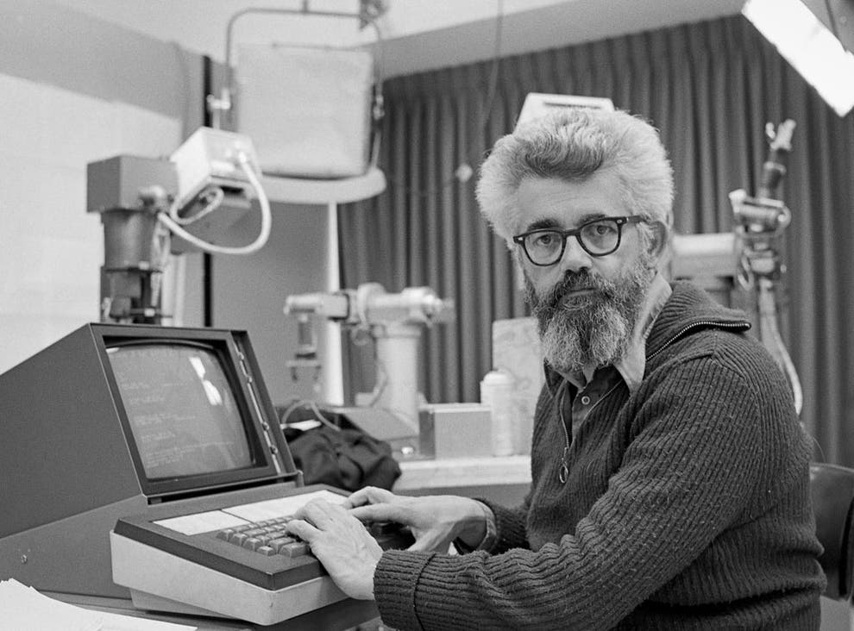
John McCarthy: Computer scientist known as the father of AI
John McCarthy, an American computer scientist pioneer and inventor, was known as the father of Artificial Intelligence (AI) after playing a seminal role in defining the field devoted to the development of intelligent machines.

Slide 20
The Dartmouth Conference and the Name Artificial Intelligence
J. McCarthy, M. L. Minsky, N. Rochester, and C.E. Shannon. August 31, 1955. "We propose that a 2 month, 10 man study of artificial intelligence be carried out during the summer of 1956 at Dartmouth College in Hanover, New Hampshire. The study is to proceed on the basis of the conjecture that every aspect of learning or any other feature of intelligence can in principle be so precisely described that a machine can be made to simulate it."

Slide 21
TURING TEST
In 1950, Alan Turing introduced a test to check whether a machine can think like a human or not, this test is known as the Turing Test.
In this test, Turing proposed that the computer can be said to be an intelligent if it can mimic human response under specific conditions.
Turing Test was introduced by Turing in his 1950 paper, "Computing Machinery and Intelligence," which considered the question, "Can Machine think?"

Slide 22
The Turing test is based on a party game "Imitation game," with some modifications. This game involves three players in which one player is Computer, another player is human responder, and the third player is a human Interrogator, who is isolated from other two players and his job is to find that which player is machine among two of them.
Consider, Player A is a computer, Player B is human, and Player C is an interrogator. Interrogator is aware that one of them is machine, but he needs to identify this on the basis of questions and their responses.

Slide 23
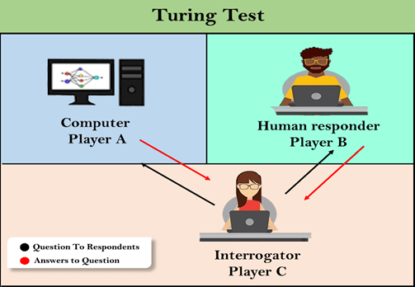
"In 1991, the New York businessman Hugh Loebner announces the prize competition, offering a $100,000 prize for the first computer to pass the Turing test. However, no AI program to till date, come close to passing an undiluted Turing test".

Slide 24
History of AI: Chinese Room
The argument and thought-experiment now generally known as the Chinese Room Argument was first published in a 1980 article by American philosopher John Searle .
It has become one of the best-known arguments in recent philosophy.
Searle imagines himself alone in a room following a computer program for responding to Chinese characters slipped under the door.
Searle understands nothing of Chinese, and yet, by following the program for manipulating symbols and numerals just as a computer does, he sends appropriate strings of Chinese characters back out under the door, and this leads those outside to mistakenly suppose there is a Chinese speaker in the room.

Slide 25
Understanding
Searle’s Chinese Room
Notes:
A Commemorative Certificate for ascending the great wall in China. (input)
I have ascended the great wall (output)

Slide 26
The narrow conclusion of the argument is that programming a digital computer may make it appear to understand language but could not produce real understanding. Hence the “Turing Test” is inadequate.
Searle argues that the thought experiment underscores the fact that computers merely use syntactic rules to manipulate symbol strings, but have no understanding of meaning or semantics.

Slide 27
Applications of AI: Natural Language Processing
Natural language processing is a subfield of linguistics, computer science, and artificial intelligence concerned with the interactions between computers and human language, in particular how to program computers to process and analyze large amounts of natural language data.
Natural language processing tools can help businesses analyze data and discover insights, automate time-consuming processes, and help them gain a competitive advantage.

Slide 28
Natural Language Processing
The most interesting applications of natural language processing in business:
1.Sentiment Analysis
2.Text Classification
3.Chatbots & Virtual Assistants
4.Text Extraction
5.Machine Translation
6.Text Summarization
7.Market Intelligence
8.Auto-Correct
9.Intent Classification
10.Urgency Detection
11.Speech Recognition

Slide 29
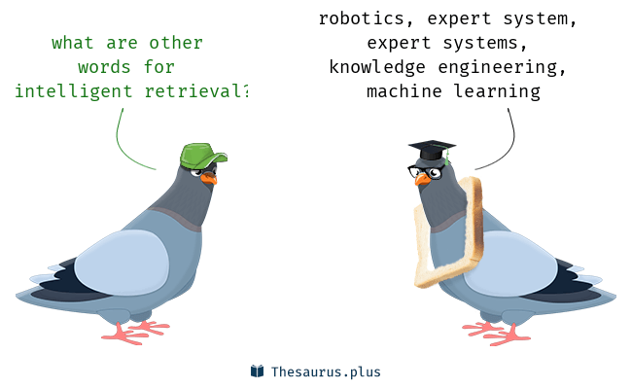
Intelligent Retrieval from Databases
Intelligent retrieval from databases is the application of artificial intelligence techniques to the task of efficient retrieval of information from very large databases. Using such techniques, significant increase in efficiency can be obtained.
Some of these improvements are not available through standard methods of database query optimization.

Slide 30
Applications of AI: Expert Systems
An expert system is a computer program that is designed to solve complex problems and to provide decision-making ability like a human expert.
It performs this by extracting knowledge from its knowledge base using the reasoning and inference rules according to the user queries.
One of the common examples of an ES is a suggestion of spelling errors while typing in the Google search box.

Slide 31
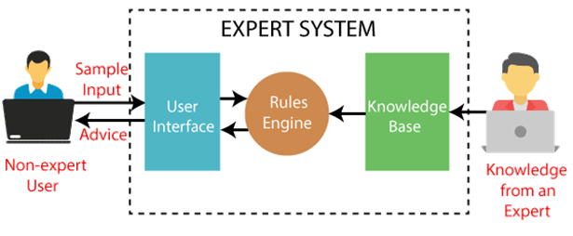
Block diagram that represents the working of an expert system:

Slide 32
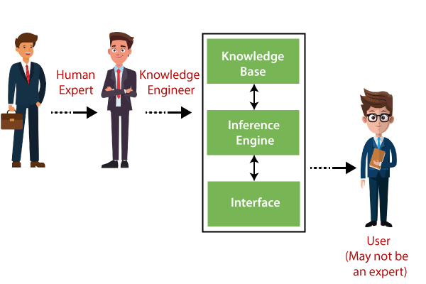
Components of Expert System
Components of Expert System
An expert system mainly consists of three components:
User Interface
Inference Engine
Knowledge Base

Slide 33
Components of Expert System
1. User Interface
With the help of a user interface, the expert system interacts with the user, takes queries as an input in a readable format, and passes it to the inference engine. After getting the response from the inference engine, it displays the output to the user. In other words, it is an interface that helps a non-expert user to communicate with the expert system to find a solution.

Slide 34
2. Inference Engine(Rules of Engine)
The inference engine is known as the brain of the expert system as it is the main processing unit of the system. It applies inference rules to the knowledge base to derive a conclusion or deduce new information. It helps in deriving an error-free solution of queries asked by the user.
With the help of an inference engine, the system extracts the knowledge from the knowledge base.
There are two types of inference engine:
Deterministic Inference engine: The conclusions drawn from this type of inference engine are assumed to be true. It is based on facts and rules.
Probabilistic Inference engine: This type of inference engine contains uncertainty in conclusions, and based on the probability.

Slide 35
Inference engine uses the below modes to derive the solutions:
Forward Chaining: It starts from the known facts and rules, and applies the inference rules to add their conclusion to the known facts.
Backward Chaining: It is a backward reasoning method that starts from the goal and works backward to prove the known facts.

Slide 36
3. Knowledge Base
The knowledgebase is a type of storage that stores knowledge acquired from the different experts of the particular domain. It is considered as big storage of knowledge. The more the knowledge base, the more precise will be the Expert System.
It is similar to a database that contains information and rules of a particular domain or subject.
One can also view the knowledge base as collections of objects and their attributes. Such as a Lion is an object and its attributes are it is a mammal, it is not a domestic animal, etc.
Components of Knowledge Base
Factual Knowledge: The knowledge which is based on facts and accepted by knowledge engineers comes under factual knowledge.
Heuristic Knowledge: This knowledge is based on practice, the ability to guess, evaluation, and experiences.

Slide 37
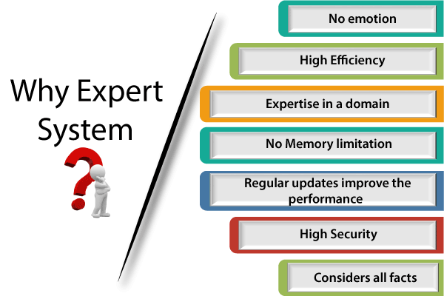

Slide 38
Applications of AI: Theorem Proving
Finding proof of a mathematical theorem requires following intelligence:
1.Requires the ability to make deductions from hypothesis
2.It demands intuitive scales such as guessing which path should be proved first in order to help proving the algorithm
3.It also requires judgments to guess accurately about which previously proven algorithms in subject area will be useful in the present proof
4.Also sometimes it is needed to break the main problem to sub- problems to work on independently

Slide 39
Theorem Proving
Proving theorems is considered to require high intelligence
If knowledge is represented by logic, theorem proving is reasoning.
A new and remarkable development here is that several researchers at Google’s research center have developed an AI theorem-proving program.
Google AI system proves over 1200 mathematical theorems
Most of these theorems were in the area of linear algebra, real analysis and complex analysis.
Mathematicians are already envisioning how this software can be used in day-to-day research

Slide 40
Applications of AI: Robotics
Robotics is an interdisciplinary branch of computer science and engineering.
Robotics develops machines that can substitute for humans and replicate human actions.
Robots can be used in many situations for many purposes, but today many are used in dangerous environments (including inspection of radioactive materials, bomb detection and deactivation), manufacturing processes, or where humans cannot survive (e.g. in space, underwater, in high heat, and clean up and containment of hazardous materials and radiation).

Slide 41
The concept of creating robots that can operate autonomously dates back to classical times, but research into the functionality and potential uses of robots did not grow substantially until the 20th century.
Throughout history, it has been frequently assumed by various scholars, inventors, engineers, and technicians that robots will one day be able to mimic human behavior and manage tasks in a human-like fashion.
Today, robotics is a rapidly growing field, as technological advances continue; researching, designing, and building new robots serve various practical purposes, whether domestically, commercially, or militarily.

Slide 42
While the overall world of robotics is expanding, a robot has some consistent characteristics:
1.Robots all consist of some sort of mechanical construction. The mechanical aspect of a robot helps it complete tasks in the environment for which it’s designed. For example, the Mars 2020 Rover’s wheels are individually motorized and made of titanium tubing that help it firmly grip the harsh terrain of the red planet.
2.Robots need electrical components that control and power the machinery. Essentially, an electric current (a battery, for example) is needed to power a large majority of robots.
3.Robots contain at least some level of computer programming. Without a set of code telling it what to do, a robot would just be another piece of simple machinery. Inserting a program into a robot gives it the ability to know when and how to carry out a task.

Slide 43
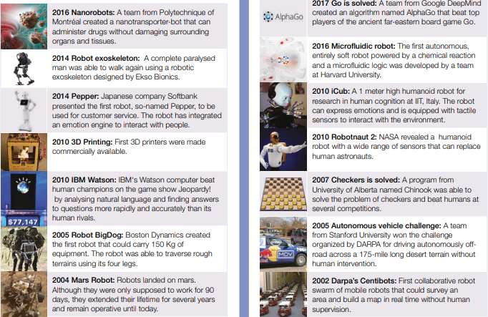
ROBOTICS AND AI

Slide 44
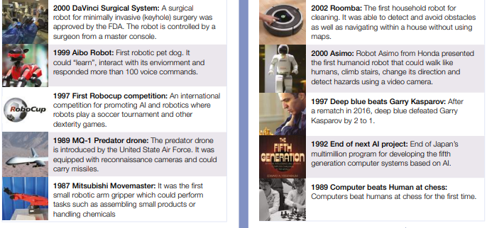

Slide 45
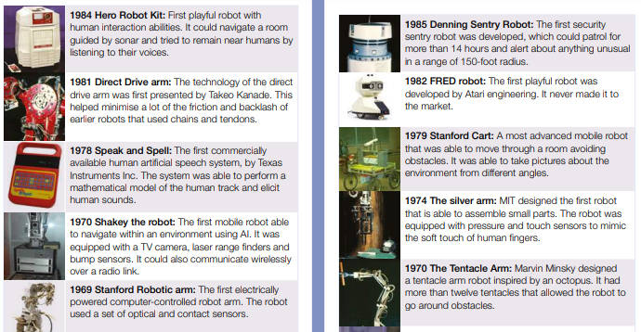

Slide 46
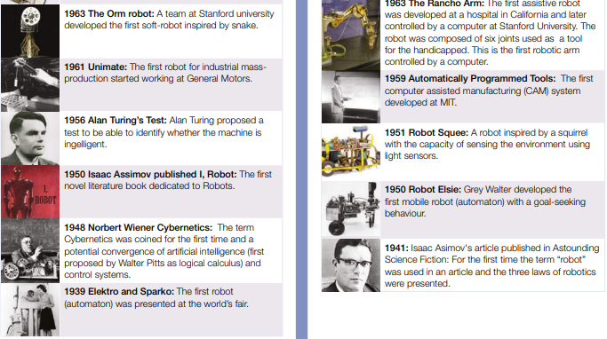

Slide 47
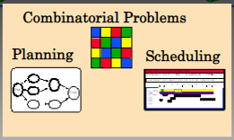
Applications of AI: Combinatorial and Scheduling Problems
Combinatorial and Scheduling Problems involve finding a grouping, ordering, or assignment of a discrete, finite set of objects that satisfies given conditions.
Combinatorial problems and Scheduling Problems arise in many areas of computer science and application domains:
1.Finding shortest/cheapest round trips (TSP)
2.Finding models of propositional formulae (SAT)
3.Planning, scheduling, time-tabling
4.Internet data packet routing
5.Protein structure prediction

Slide 48
Applications of AI: Perception Problems
Perception in Artificial Intelligence is the process of interpreting vision, sounds, smell, and touch.
Perception helps to build machines or robots that react like humans.
Perception is a process to interpret, acquire, select, and then organize the sensory information from the physical world to make actions like humans.
Perception is important for creating an artificial sense of self-awareness in the robot.

Slide 49
Neural Network Architectures
The Neural Network architecture is made of individual units called neurons that mimic the biological behavior of the brain.
The input data is processed through different layers of artificial neurons stacked together to produce the desired output.
From speech recognition and person recognition to healthcare and marketing, Neural Networks have been used in a varied set of domains.

Slide 50
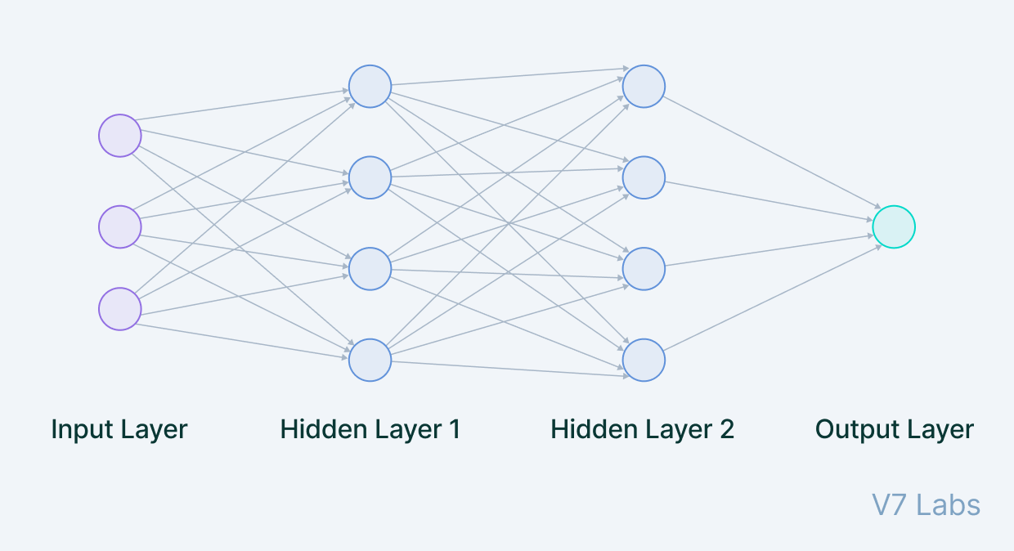
Key Components of the Neural Network Architecture
The Neural Network architecture is made of individual units called neurons that mimic the biological behavior of the brain.

Slide 51
Input Layer
The data that we feed to the model is loaded into the input layer from external sources like a CSV file or a web service.
It is the only visible layer in the complete Neural Network architecture that passes the complete information from the outside world without any computation.

Slide 52
Hidden Layers
The hidden layers are what makes deep learning what it is today. They are intermediate layers that do all the computations and extract the features from the data.
There can be multiple interconnected hidden layers that account for searching different hidden features in the data.
For example, in image processing, the first hidden layers are responsible for higher-level features like edges, shapes, or boundaries.
On the other hand, the later hidden layers perform more complicated tasks like identifying complete objects (a car, a building, a person).

Slide 53
Output Layer
The output layer takes input from preceding hidden layers and comes to a final prediction based on the model’s learnings. It is the most important layer where we get the final result.
In the case of classification/regression models, the output layer generally has a single node. However, it is completely problem-specific and dependent on the way the model was built.

Slide 54
Game Playing in Artificial Intelligence
Game Playing is an important domain of artificial intelligence.
Games don’t require much knowledge; the only knowledge we need to provide is the rules, legal moves and the conditions of winning or losing the game.
Game playing provided numerous applications that motivated the development of AI techniques, such as search and problem-solving techniques.
In addition, it served as a popular benchmark for demonstrating progress and improvements of AI research.

Slide 55
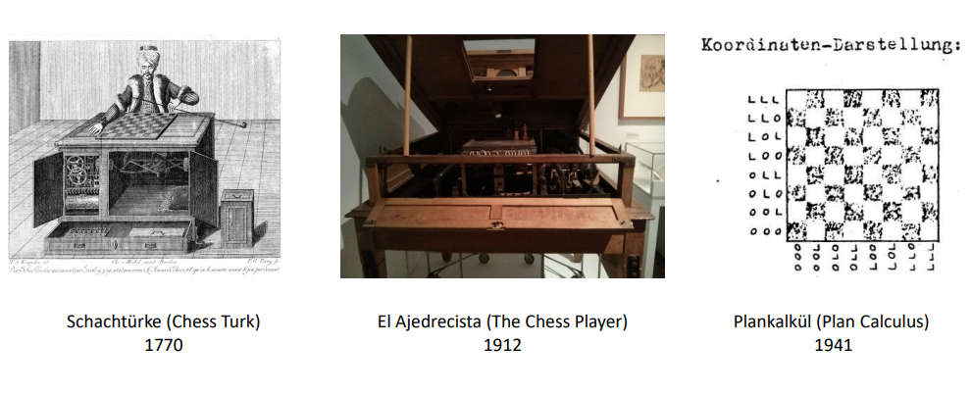
History of Game playing

Slide 56
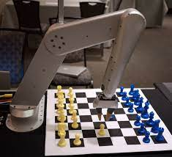
Game theory has its history from 1950, almost from the days when computers became programmable. The very first game that is been tackled in AI is chess.

Slide 57
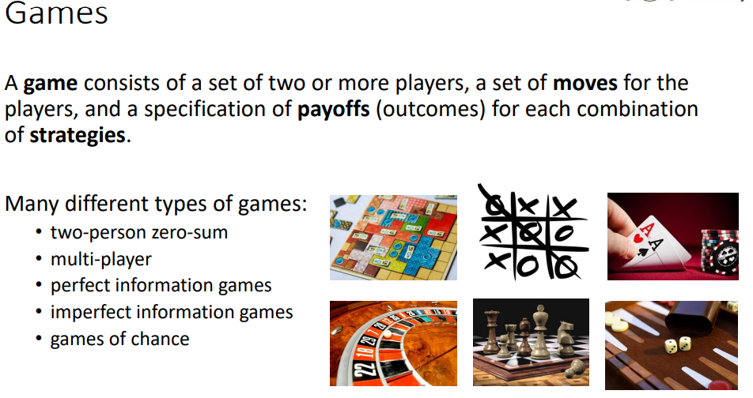

Slide 58
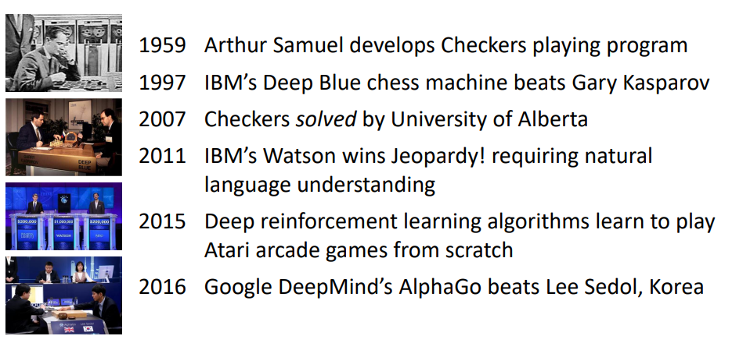
Milestones in AI Game Playing

Slide 59
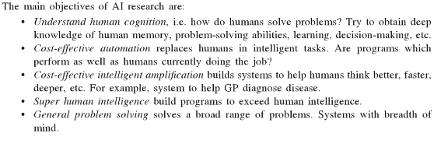
Objectives of AI

Slide 60
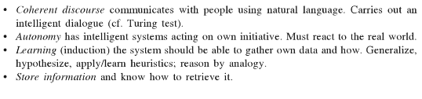
Objectives of AI

Slide 61
Artificial Intelligence Programming
A computer language developed expressly for implementing artificial intelligence (AI) research.
In 1960 John McCarthy, a computer scientist at the Massachusetts Institute of Technology (MIT), produce the programming language LISP (List Processing), which remains the principal language for AI work in the United States.

Slide 62
The conventional software engineering approach to programming emphasizes on starting with requirements, developing formal specifications, breaking the problem into parts and coding at a late stage in the development.
Programming artificial intelligence systems does not fit so easily into conventional software engineering models.
The correctness of an AI system is measured not by its performance, but by its closeness to human performance. This leads to an approach to programming described as "exploratory" or "prototyping".

Slide 63
An AI program may be tested against a range of human examples and, if necessary, modified so that it performs as a human on those examples. Some modifications may prove successful in improving performance (as measured by closeness to human performance) over a variety of examples.
This process may go through several cycles, each cycle building a better prototype. This has been described as the Run-Understand-Debug-Edit (RUDE) approach to programming.

Slide 64
Early work on AI was done in the language LISP.
PROLOG, now the preferred language for many Al programmers, has the list processing and symbolic manipulation qualities of LISP.
The idea of the developers of PROLOG was that it would be simply machine-executable logic, which would mean that a PROLOG program would be its own specification.

Slide 65
PROLOG can determine whether or not a given statement follows logically from other given statements.
For example, given the statements “All logicians are rational” and “Robinson is a logician,” a PROLOG program responds in the affirmative to the query “Robinson is rational?”
PROLOG is widely used for AI work, especially in Europe and Japan.
Automatic Programming: Automatic programming is a type of computer programming where program code is automatically generated by another program based on certain specifications.
The high-level programming languages such as Fortran and ALGOL translated into low-level machine code.

Slide 66
Thus an AI program developed in an exploratory way would still be fully specified.
The equation ALGORITHM = LOGIC + CONTROL was suggested, stressing that the programmer needs simply specify logic relationships between the data and the control which is managed by the computer.

Slide 67
Criticism of AI
A criticism of AI is that it is simply about solving tricky problems.
For example, that if we have the facts p(x)q(x), where x is a variable, and p(a), where a is a constant, we can conclude q(a).
As a typical example, suppose we say "all Computer Science students take Logic" and we can express that by CompSci(X) → Logic(X). Then if we have the fact "Gopal is a Computer Science student", expressed by CompSci(Gopal), and we can conclude Logic(Gopal), i.e. "Gopal takes Logic"

Slide 68
Future of AI
The future main directions of research and development in AI can be bundled up in three terms.
1.Information Creation: Information Creation is a Process refers to the understanding that the purpose, message, and delivery of information are intentional acts of creation.
2. Autonomy: AI systems are autonomous to the extent that they can make individual decisions without direct human interference

Slide 69
Future of AI
3.Situatedness:In artificial intelligence and cognitive science, the term situated refers to an agent which is embedded in an environment.
The term situated is commonly used to refer to robots, but some researchers argue that software agents can also be situated if:
they exist in a dynamic (rapidly changing) environment, which they can manipulate or change through their actions, and which they can sense.

Slide 70
Future of AI.
AI may be the most transformative technology humans have ever developed.
How will it continue to evolve and develop in the future?
Here are some predictions.

Slide 71
1. AI Workforce Augmentation
In the future, we’ll see even more of our jobs being outsourced to AI. Artificial intelligence can now do amazing things like read, write, speak, and smell that previously only humans could do.
That frees up humans to do the things we do best on the jobs, like being creative and practicing emotional intelligence.

Slide 72
2. Better Language Modeling Capability
Language modeling is the process that allows machines to understand and communicate with us in ways we understand. We can even use it to take natural human language and turn it into computer code that can run programs and applications.
Recently, we have seen the release of GPT-3 by OpenAI, the most advanced and largest language model ever created, consisting of around 175 billion parameters for processing language.
OpenAI is already working on its successor, GPT-4, which will be even more powerful. Although the details haven't been confirmed, some people believe it will contain up to 100 trillion parameters, making it 500 times larger than GPT-3.
In theory, that would take it one giant step closer to being able to create language and hold conversations that are indistinguishable from those of a human. This model will also become much better at creating computer code.

Slide 73
3. Cybersecurity
This year, the World Economic Forum noted that cybercrime may actually pose a more significant risk to society than terrorism. As machines take over more of our lives, hacking and cybercrime inevitably become bigger and more dangerous problems.
The good news is that artificial intelligence can be a helpful weapon against cybercrime, because AI is quite good at analyzing network traffic and recognizing patterns.

Slide 74
4. The Metaverse
The word “metaverse” describes a unified, persistent, digital environment where users can work and play together. It's a virtual world like the internet, but with the emphasis on enabling immersive experiences that are created or enabled by users.
Companies like Meta, Microsoft, and Epic Games are helping to build the metaverse, and AI will be a key component of creating online immersive environments where humans can feel at home and explore their creative impulses.

Slide 75
5. Low-Code or No-Code AI
In the not-so-distant past, you needed specialized coding skills to create even simple websites. But these days, we have drag-and-drop graphical interfaces that make it easy to create websites and post new content with just a few clicks.
In the future, the same thing will happen with artificial intelligence and machine learning. We will have simple tools we can use to build our AI so we are less reliant on coding skills and can still use AI to develop more and more applications.

Slide 76
6. Data-Centric AI
Traditionally, artificial intelligence has relied on big data. We needed huge volumes of data to train the AI's algorithms and neural networks, so they were software-centric.
The latest trend is becoming more focused on the data, because many applications beyond the world of big tech have access to billions of unique, structured data sets.
For those companies to use AI, they need to rely on high-quality data, and they will need domain expertise from people to help label the data. With that data, they can use AI and machine learning to develop better technologies.

Slide 77
7. Autonomous Cars
Tesla says its cars will demonstrate full self-driving capability by 2022. Its competitors – which include Google, Apple, General Motors, and Ford – are all expected to announce major leaps forward in the autonomous car space in the next year.
In the year 2022, we will also likely see the first autonomous ship crossing the Atlantic from the U.K. to the U.S.

Slide 78
8. Creative AI
Creativity is often seen as strictly a human skill. But now, artificial intelligence can pull off creative tasks, including designing logos, songwriting, creating infographics, and writing blog posts.
The creative side of AI will simply explode over the coming years as we see new capabilities emerging.

